Slide 1
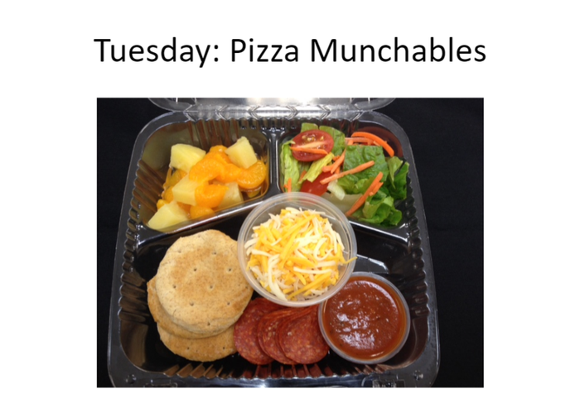
September 2019
Monthly Food Service Report
Knox County R1
Hard to believe that almost a month of school has already flown by. I want to first say how proud of my staff I am. I was gone to open a new school in Iowa for three weeks and they all stepped up and did an amazing job.
Our mission:
“Make Their Day”
OPAA! Core Values
Act in the best interest of the students, schools, and communities we serve
Be honest in everything we do
Have a passion to serve others
Commit to continuous improvement
NEW Program
We have recently started a new program in the Elementary called Grab N Go Breakfast. We prepare the meal in the kitchen and take it down to the elementary morning meeting room. The kids can grab it and go eat outside or stay in the morning meeting room. So far it has been a big hit and has already increased the breakfast participation. The kids have this option, or they can still go up to the high school and eat regular breakfast.
Visit Our Website:
opaafood.com
Kisha Goodwin
Director of Nutritional Services
660-341-2303
kgoodwin@opaafood.com
OPAA! Food Management Inc.
636-812-0777
888-860-3236
Starting in October we will be starting OPAA to Go for our elementary kids. This will be a fourth option for grades K-5

